Slide 1
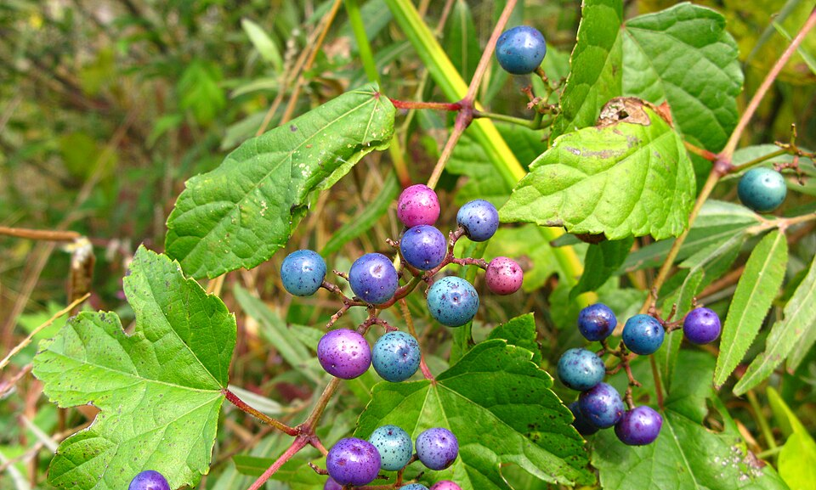

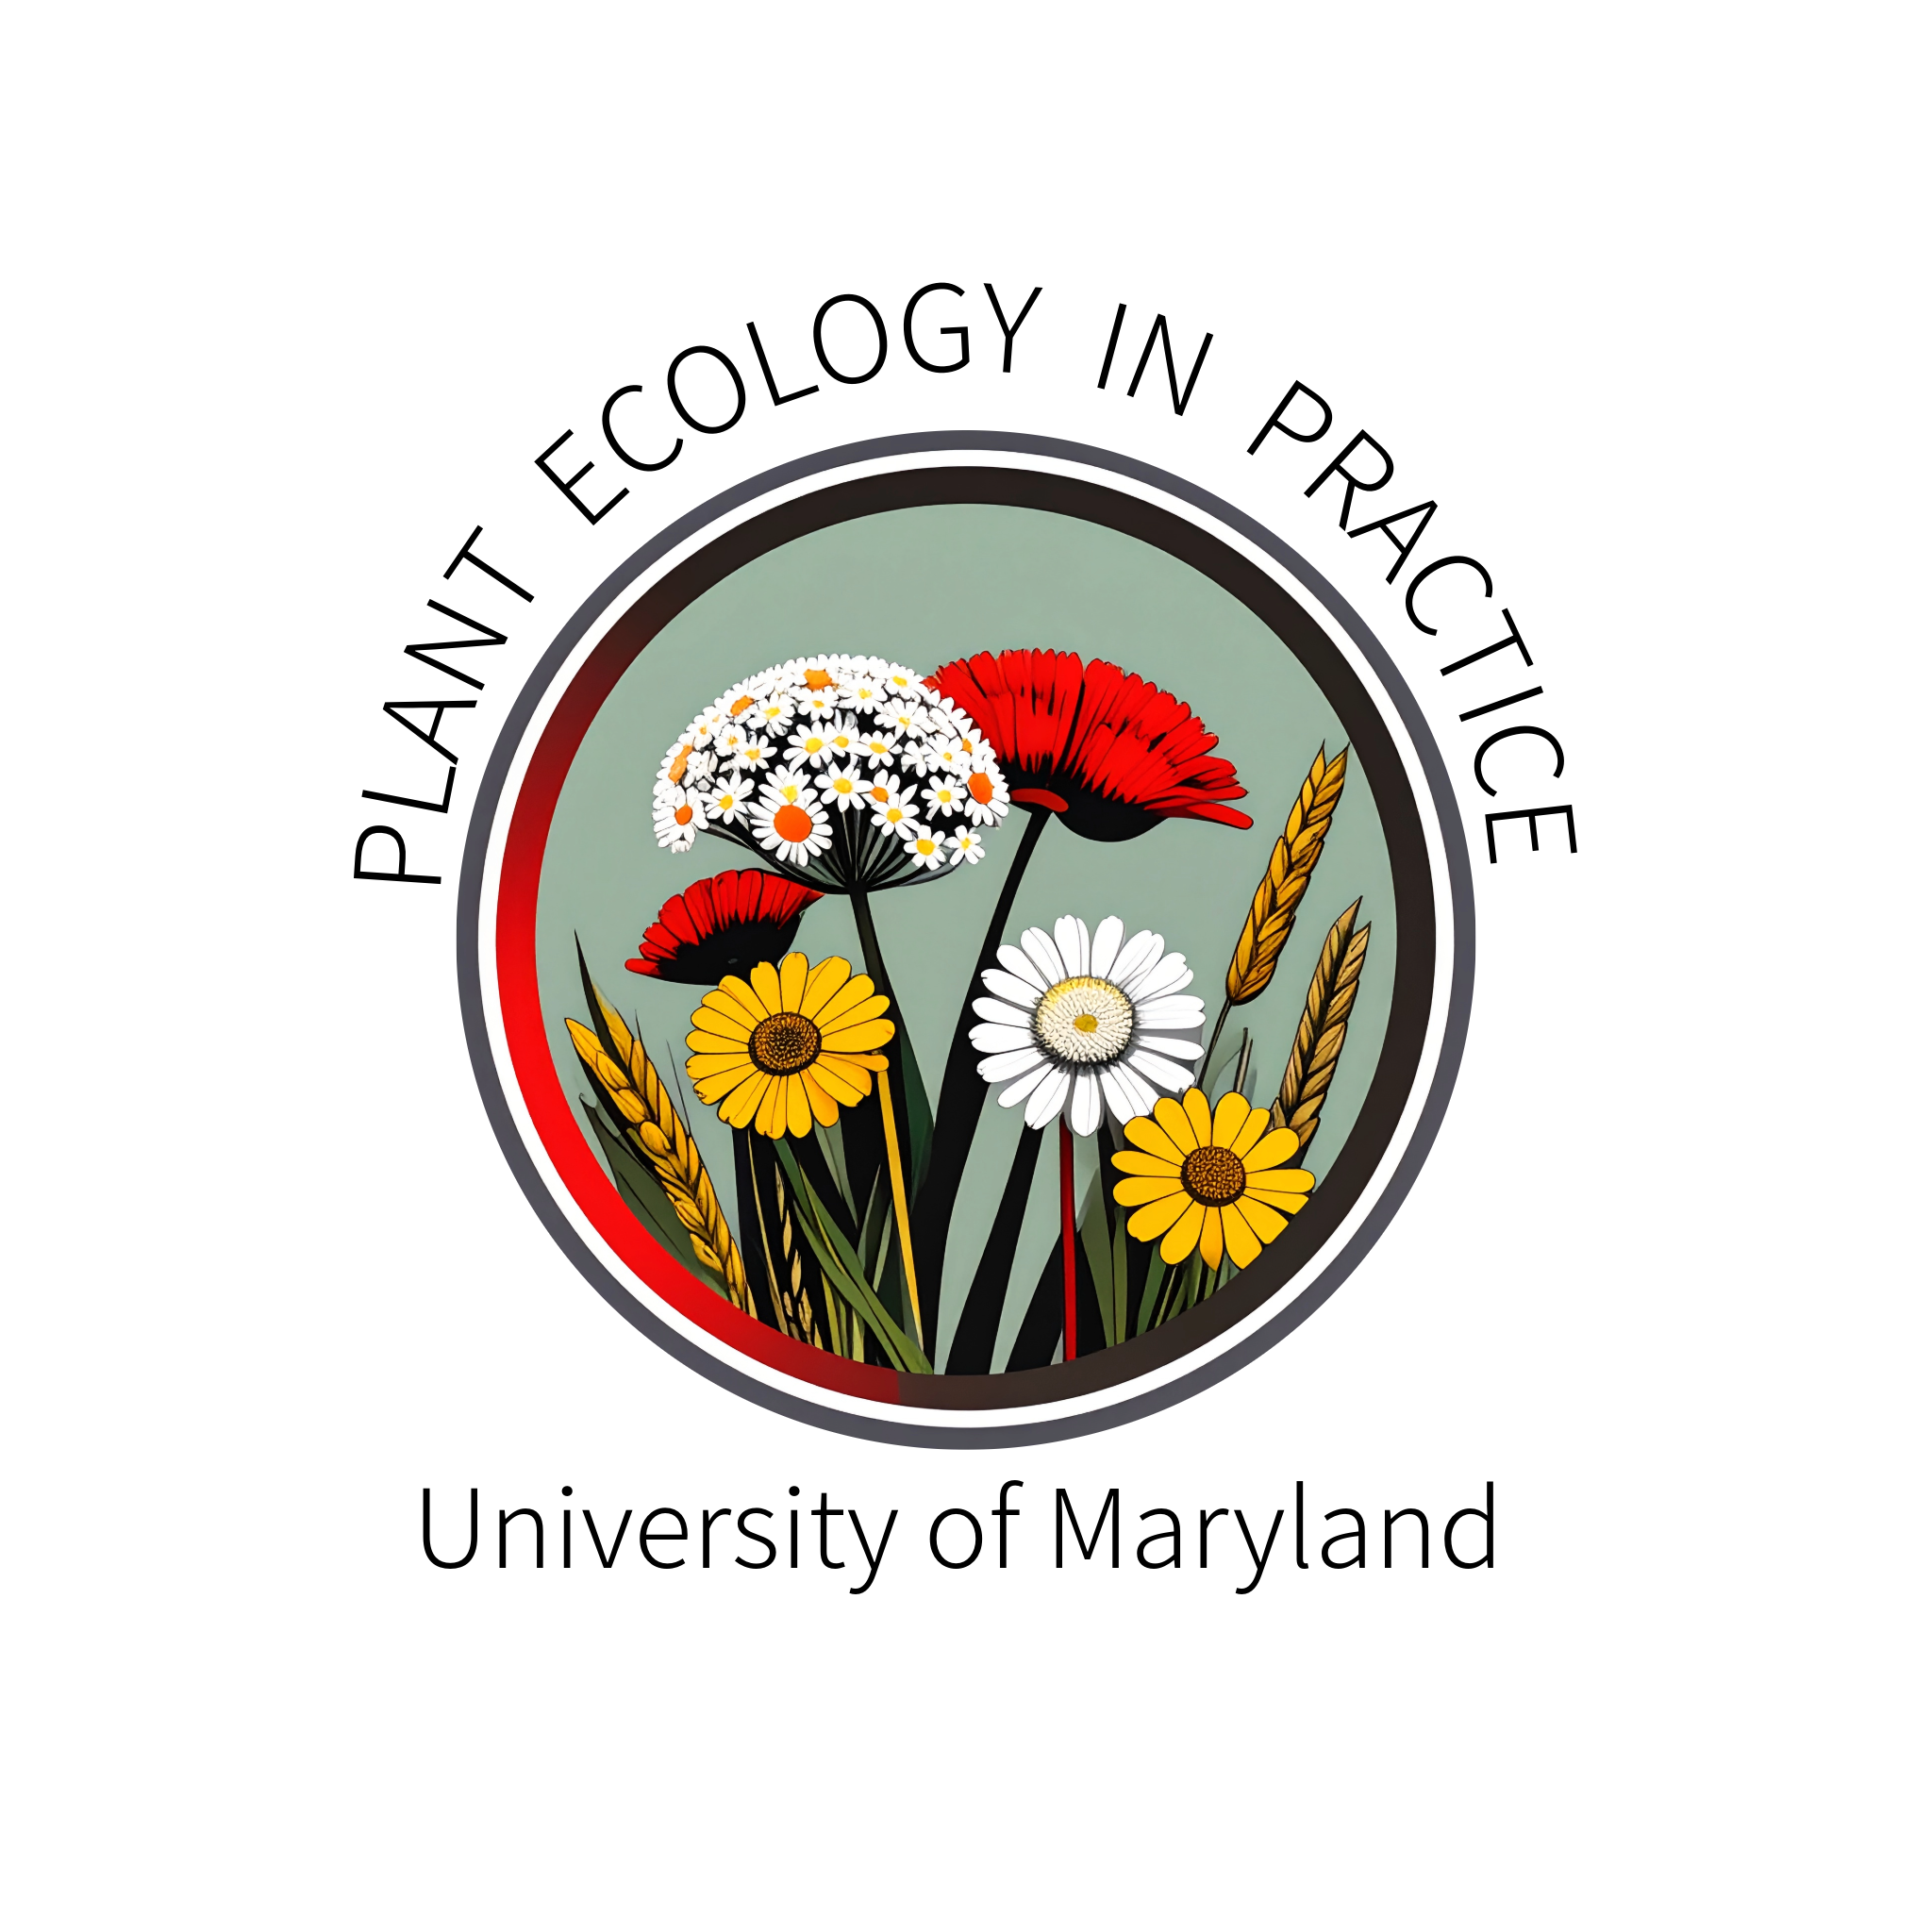
Invasive Species and Climate Change:
Resources for Landscape Planning and Management Decisions
Dan Buonaiuto, PhD
New Directions in the American Landscape
2026

Slide 2

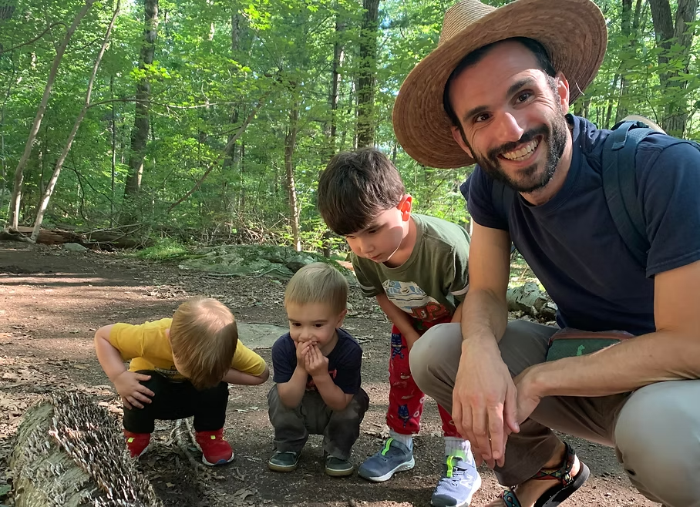
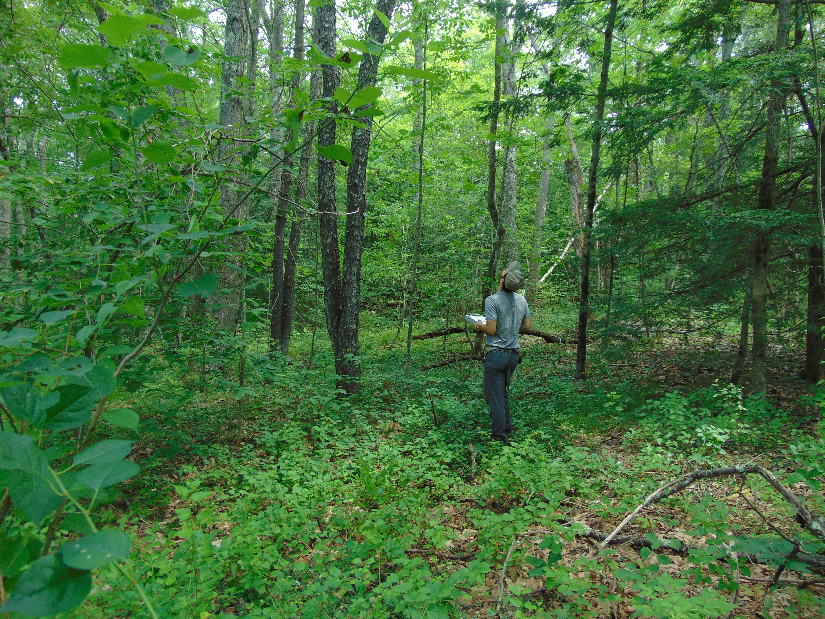
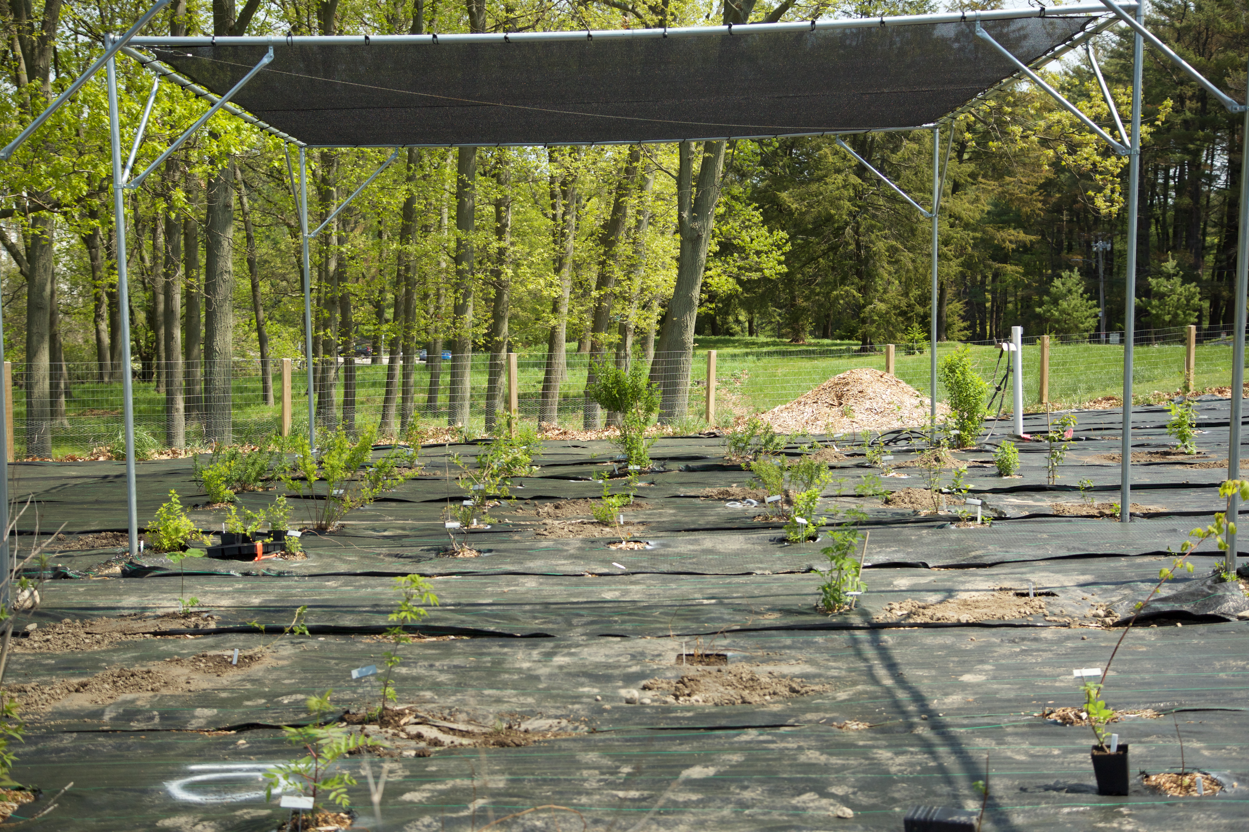


dbuona@umd.edu
Notes:
The Plant Ecology in Practice (PEP) lab group at the University of Maryland is dedicated to
addressing fundamental questions in plant ecology while considering their applications
in horticulture, natural resource management, conservation and ecological restora-
tion.
Research in the PEP lab addresses a wide range of topics related to the responses of plant com-
munities to environmental variation in the context of climate change and biological invasions.
Our ultimate question: How will the diversity and function of ecological commu-
nities shift in response to global change, and how can we most effectively and
sustainably guide this trajectory?

Slide 3

AGENDA
1
Invasive species and climate change: R.I.S.C.C.-y business
2
M.A.D. about climate change
3
Relocation-managed

Slide 4
1
Regional cases studies for global challenges
2
3

Slide 5
1
Regional cases studies for global challenges
2
Ecologist’s perspective
3

Slide 6
1
Regional cases studies for global challenges
2
Ecologist’s perspective
3
Potential partnerships

Slide 7
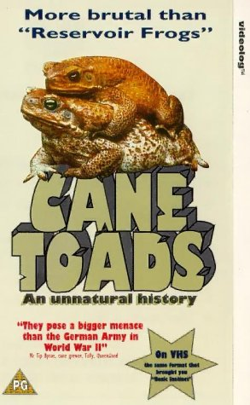
Invasive species are bad enough

Slide 8
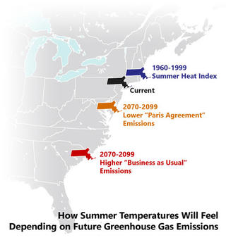
Now climate change?

Slide 9
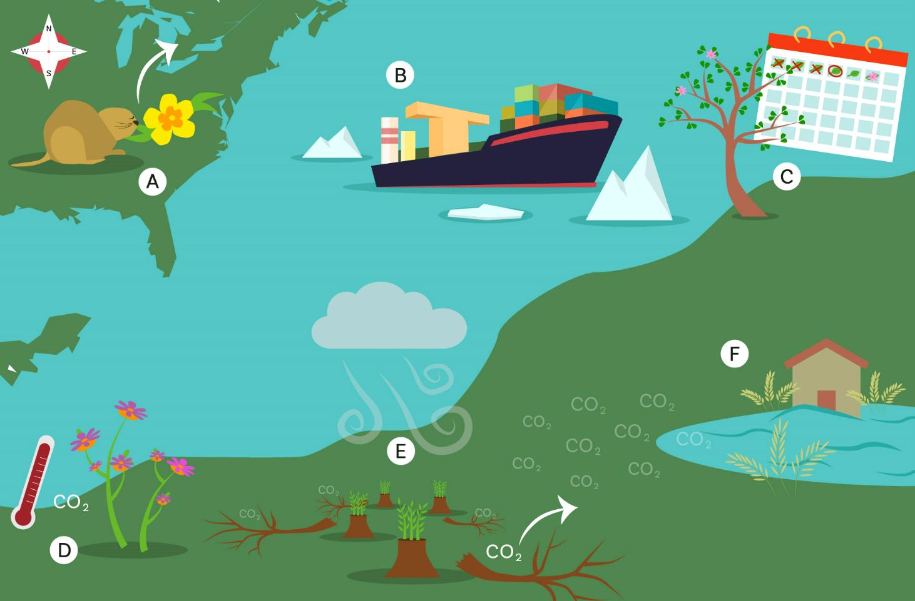
Climate change-driven range shifts present new potential invasive species to evaluate, monitor, and target
Colberg, Bradley, Morelli, & Brown-Lima 2024

Slide 10
Changes in trade and transport create novel and increased introductory pathways to monitor and regulate
Climate change-driven range shifts present new potential invasive species to evaluate, monitor, and target
Colberg, Bradley, Morelli, & Brown-Lima 2024

Slide 11
Changes in trade and transport create novel and increased introductory pathways to monitor and regulate
Climate change-driven range shifts present new potential invasive species to evaluate, monitor, and target
Shifting seasons and phenologies disrupt invasive species management timelines
Colberg, Bradley, Morelli, & Brown-Lima 2024

Slide 12
Changes in trade and transport create novel and increased introductory pathways to monitor and regulate
Climate change-driven range shifts present new potential invasive species to evaluate, monitor, and target
Shifting seasons and phenologies disrupt invasive species management timelines
Reduced treatment efficacy and feasibility reduce the likelihood of achieving desired results
Colberg, Bradley, Morelli, & Brown-Lima 2024

Slide 13
Changes in trade and transport create novel and increased introductory pathways to monitor and regulate
Climate change-driven range shifts present new potential invasive species to evaluate, monitor, and target
Shifting seasons and phenologies disrupt invasive species management timelines
Reduced treatment efficacy and feasibility reduce the likelihood of achieving desired results
Increased vulnerability of native ecosystems requires reevaluating and adjusting restoration targets
Colberg, Bradley, Morelli, & Brown-Lima 2024

Slide 14
Changes in trade and transport create novel and increased introductory pathways to monitor and regulate
Climate change-driven range shifts present new potential invasive species to evaluate, monitor, and target
Shifting seasons and phenologies disrupt invasive species management timelines
Reduced treatment efficacy and feasibility reduce the likelihood of achieving desired results
Compounding effects of extreme climate events and invasive species require integrating invasive management into extreme event preparedness
Increased vulnerability of native ecosystems requires reevaluating and adjusting restoration targets
Colberg, Bradley, Morelli, & Brown-Lima 2024

Slide 15
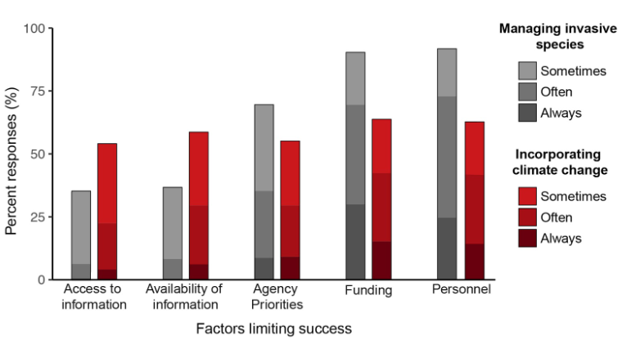
What are the barriers to good invasive species management?
Beaury et al. 2020
Notes:
200 invasive species managers in the northeast

Slide 16
What are the barriers to incorporating climate change into IS management?
Beaury et al. 2020
Notes:
200 invasive species managers in the northeast

Slide 17
What are the barriers to good invasive species management?
Scientists can help!
Beaury et al. 2020
Notes:
200 invasive species managers in the northeast

Slide 18


Established: 2016
Notes:
Toni Lyn Morelli Bethany Bradley and Carrie Brown-Lima

Slide 19
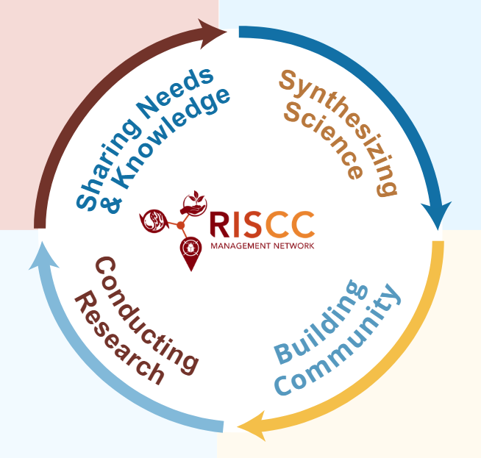
Established: 2016

Slide 20
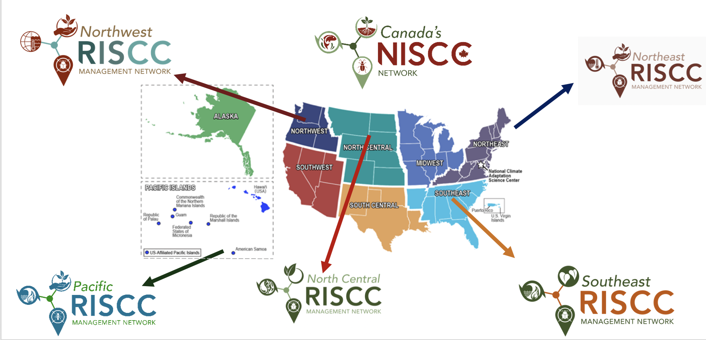
Established: 2016

Slide 21
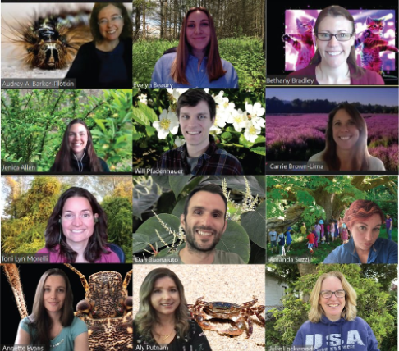
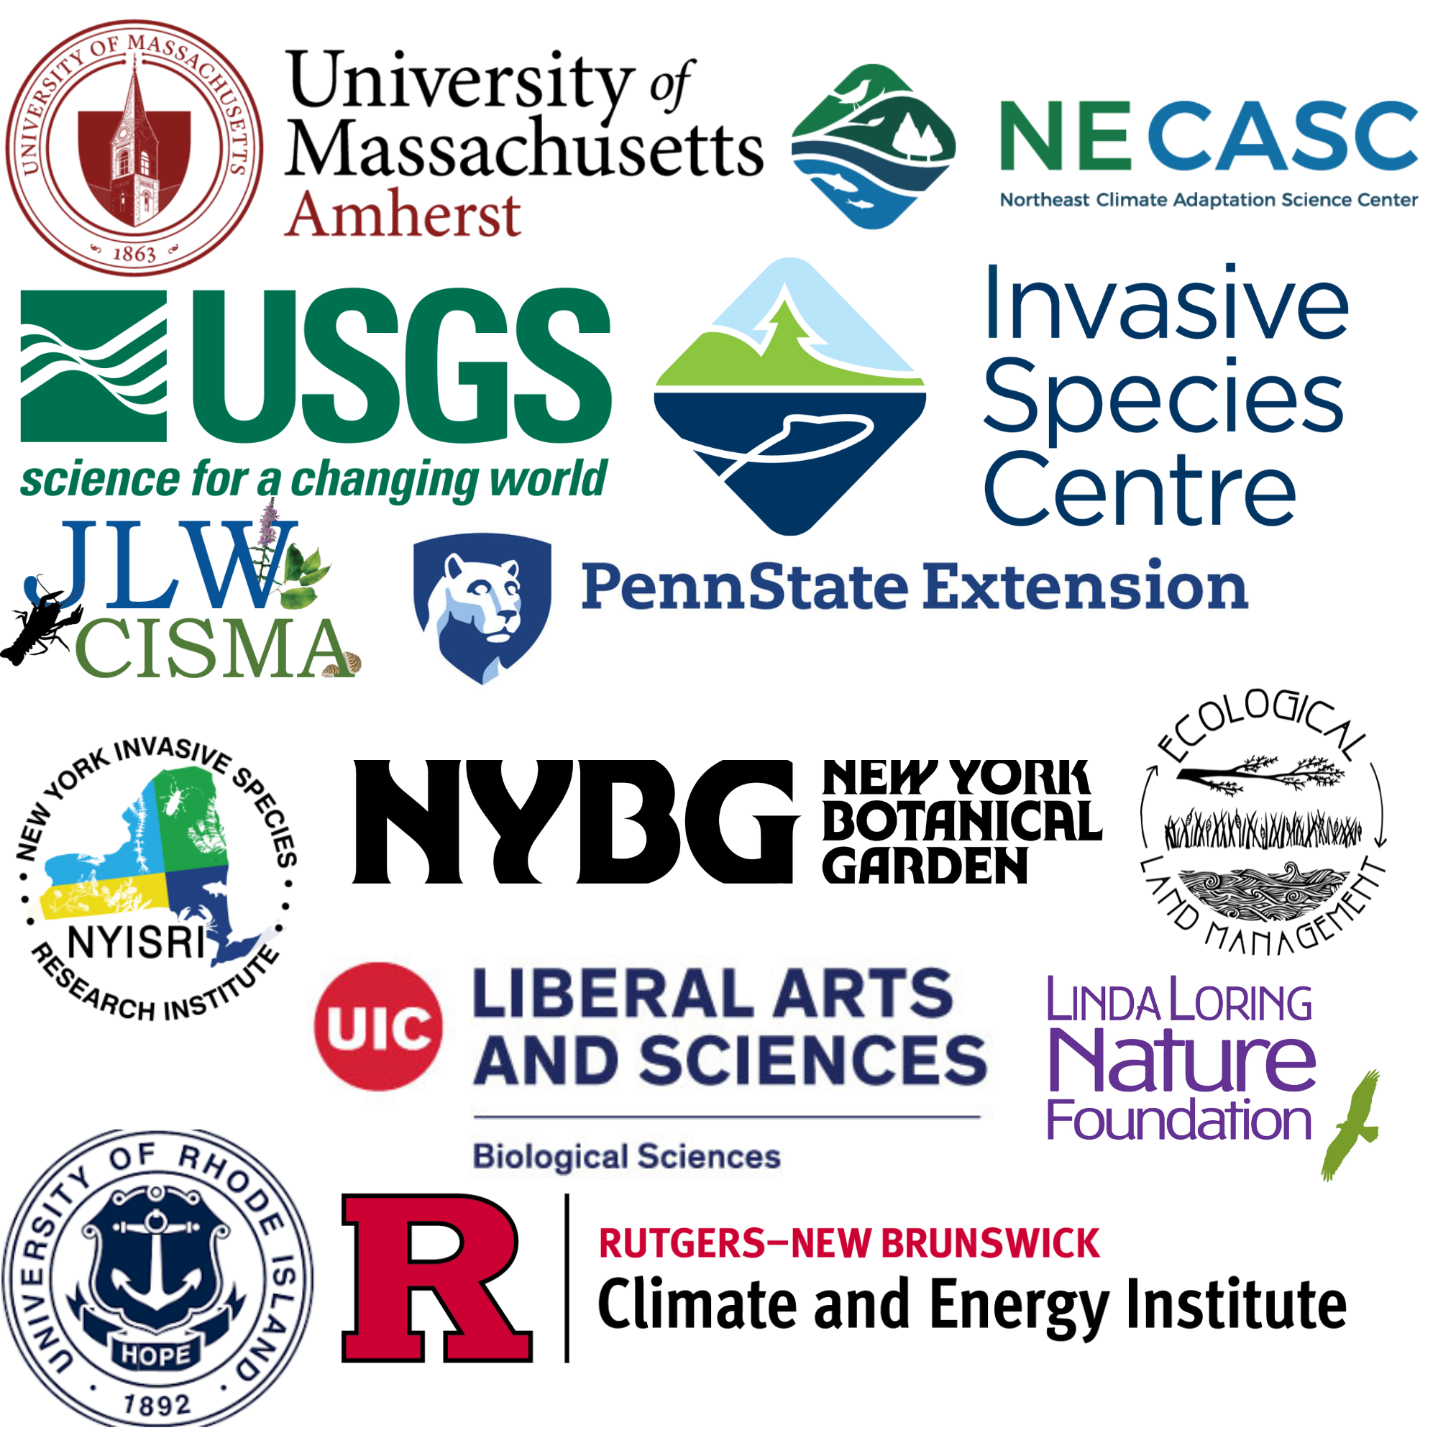
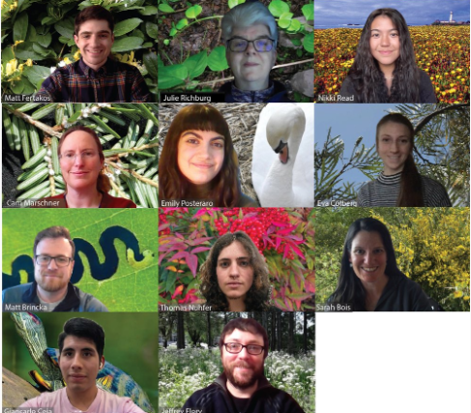

Slide 22
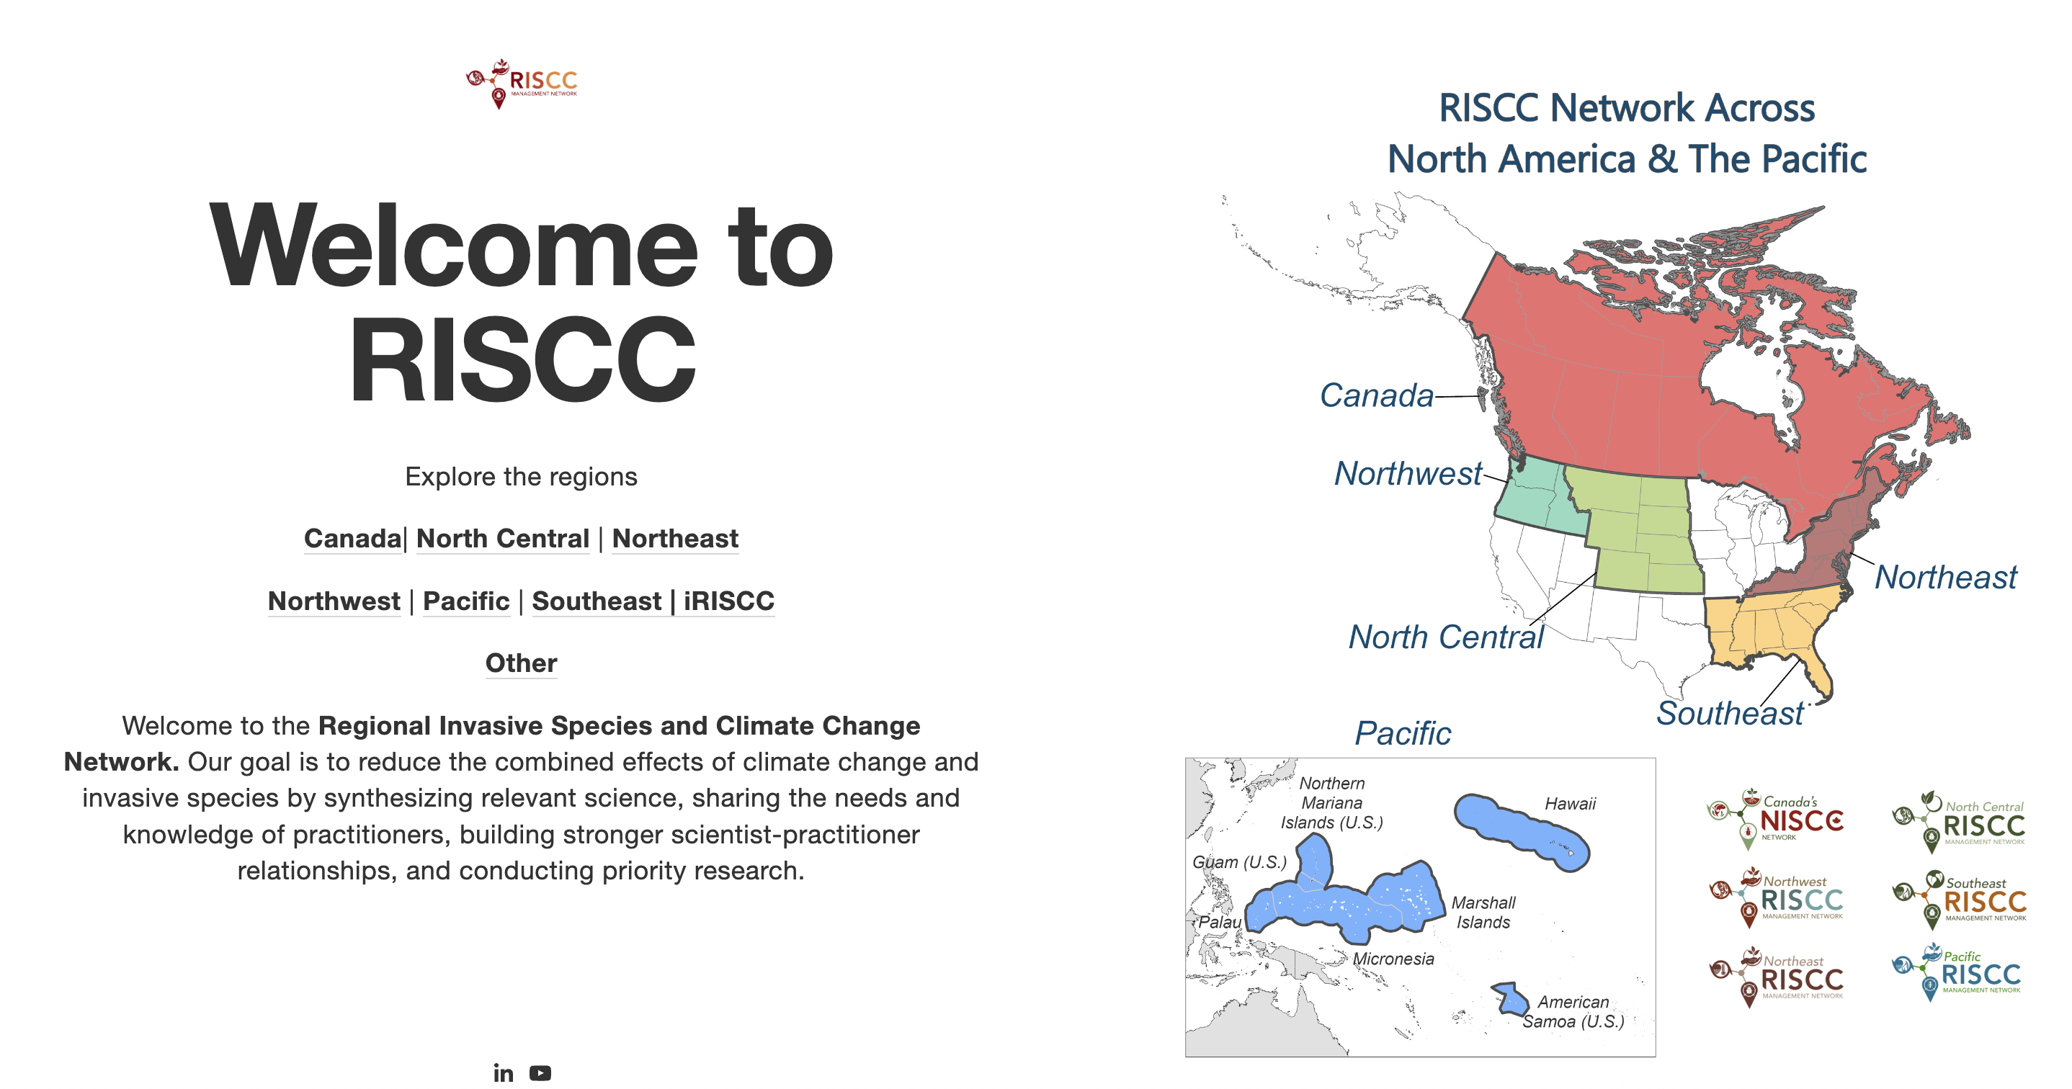

https://www.risccnetwork.org/

Slide 23
AGENDA
1
Invasive species and climate change: R.I.S.C.C.-y business
2
M.A.D. about climate change
3
Relocation-managed

Slide 24
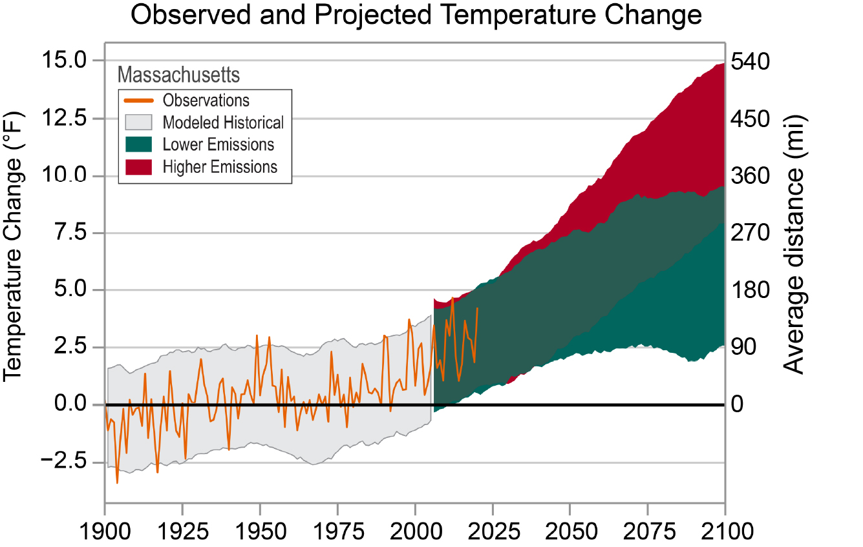

Slide 25
What does this mean for plants?

Slide 26

I’m M.A.D. about climate change
Move, Adapt, or Die

Slide 27
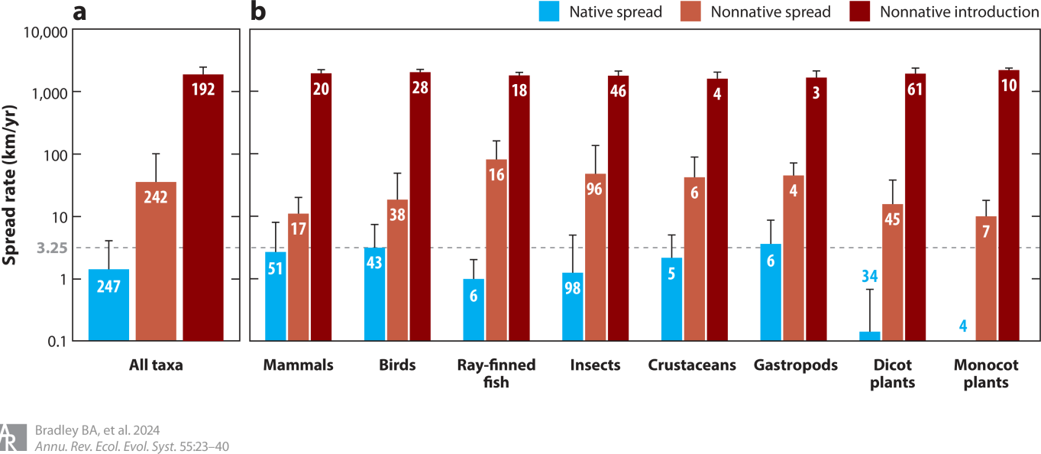
Move, Adapt, or Die
I’m M.A.D. about climate change
Bradley et al. 2024

Slide 29
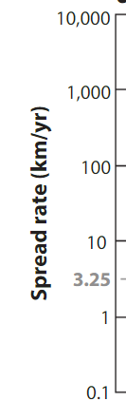
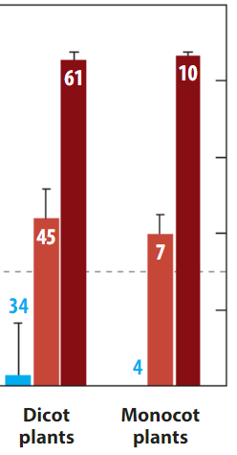
Non-native species are shifting their ranges 100x faster than native species

Slide 30
Non-native species are shifting their ranges 100x faster than native species

Slide 31
Non-native species are shifting their ranges 100x faster than native species

Slide 33
What does this mean for invasive plants?

Slide 34
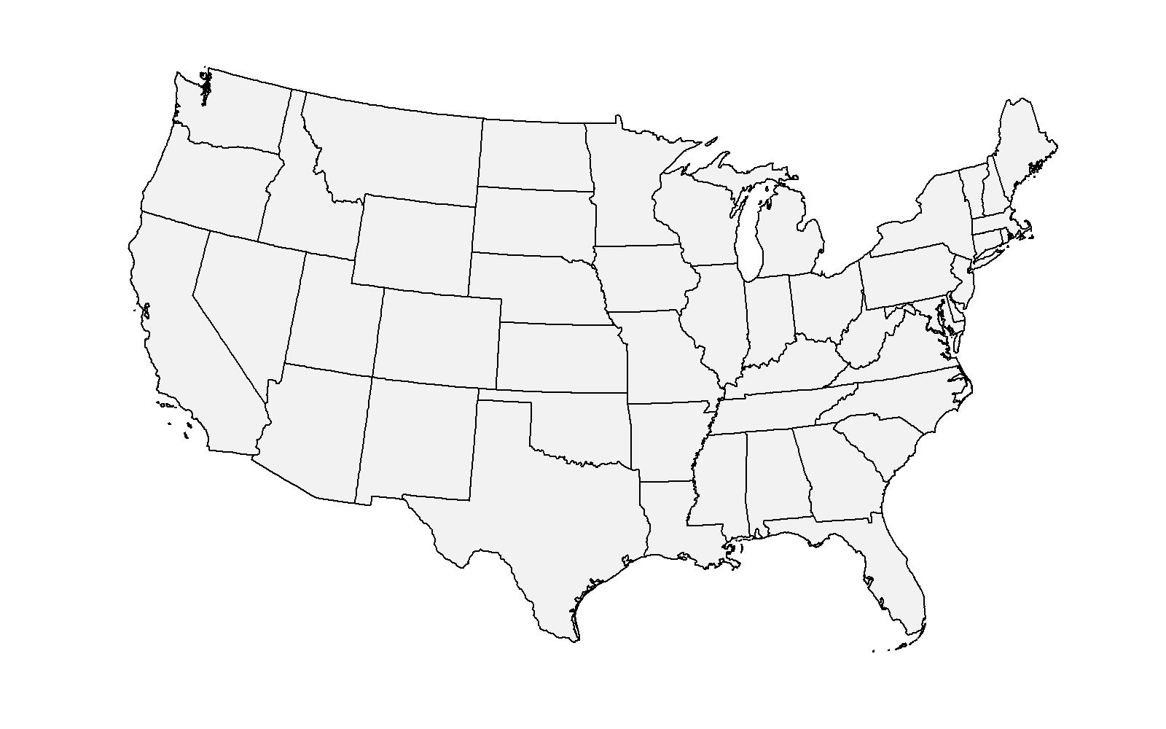
Occurrence vs. Abundance Range
Potential occurrence range
(suitable to establishment)
Potential abundance range
(high abundance likely)
Notes:
We’ve taken two approaches to modeling species ranges, one predicting where invasive plants can establish, and the other with how abundant they are likely to be across the Contiguous U.S.
Abundance is correlated with impact, so that’s helpful for identifying the species and locations that are most at risk for ecological harm from invasives. However, establishment is still useful when abundance is not available (which happens a lot). Abundance data are less abundant :-)

Slide 35
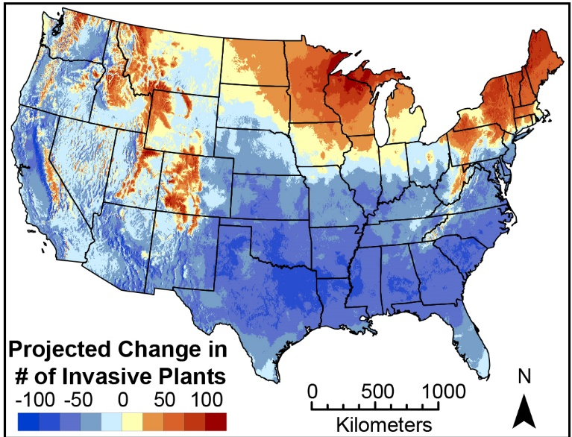
Modeled establishment ranges for ~900 terrestrial invasive plants
Allen & Bradley 2016
Notes:
The northeast is a hotspot for range shifting invasive plants. There are species already in the U.S. but not yet spread to some areas that will become suitable with climate change.

Slide 36
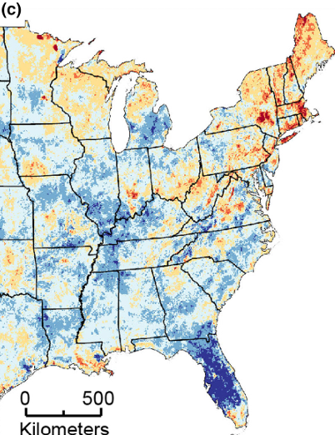
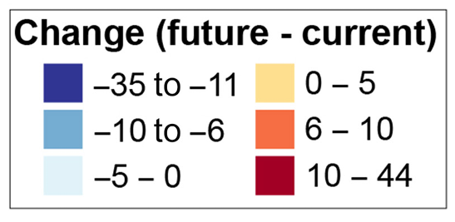
And abundance ranges for 144 terrestrial invasive plants
Evans et al. 2024
Notes:
For those that we can model abundance, we see a more fragmented pattern of geographic locations at the highest risk for fiture range shifting invasive plants, but they generally occur in the Northeast, mid-Atlantic, Appalachian, and upper Midwest regions.
HOW DO WE MAKE SENSE OF ALL THIS? GAINING AND LOSS SHIFTING ABUNDANCE
How do we make sense of these changes?

Slide 37
Non-native species are shifting their ranges 100x faster than native species
WHY?

Slide 38

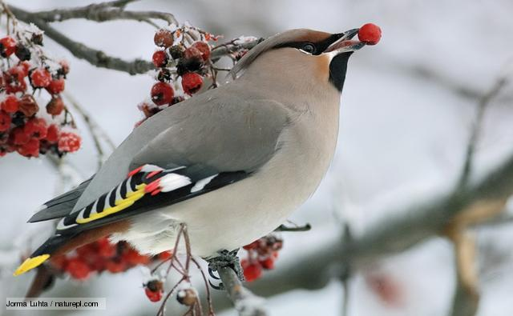

Slide 39
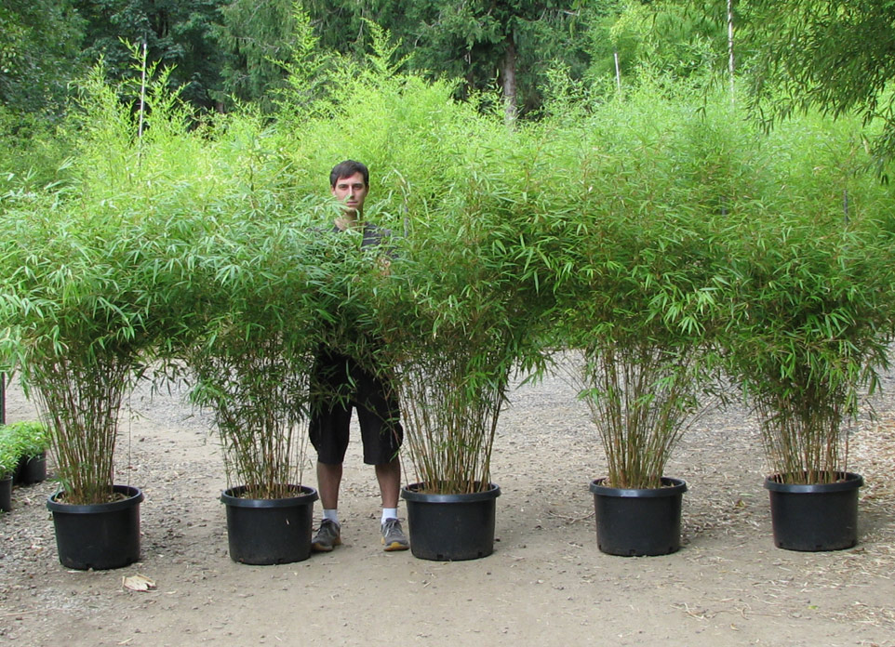

Slide 40
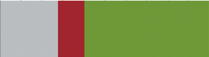
Ornamental sales are the primary pathway for invasive plant introduction
xs
Unknown
~30%
Accidental
~10%
Deliberate
~60%
Ornamental introductions
Ornamental
introductions
Introduction pathways for ~1000 invasive plants in the U.S.
Lehan et al. 2013
Notes:
Most of the introductions were deliberate, and most of the deliberate introductions were ornamental. Therefore we need to understand and collaborate with the ornamental plant industry to minimize future invasions.

Slide 41
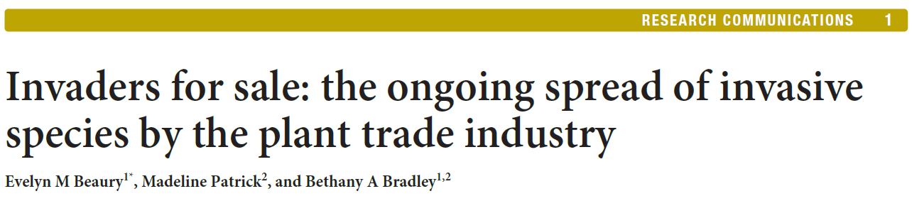
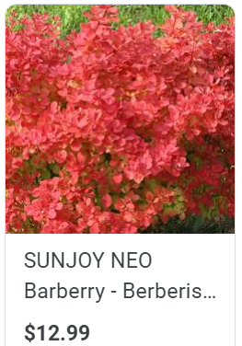
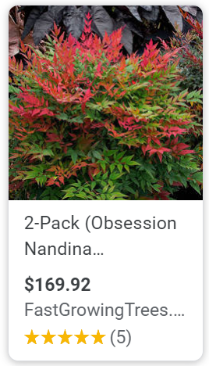
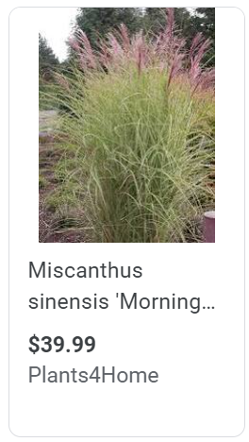
Ornamental invasive plants remain a problem
61% of 1,285 invasive plants in the U.S. are still available for sale
Beaury et al. 2021
Notes:
Including 20 species of Federal noxious weeds

Slide 42
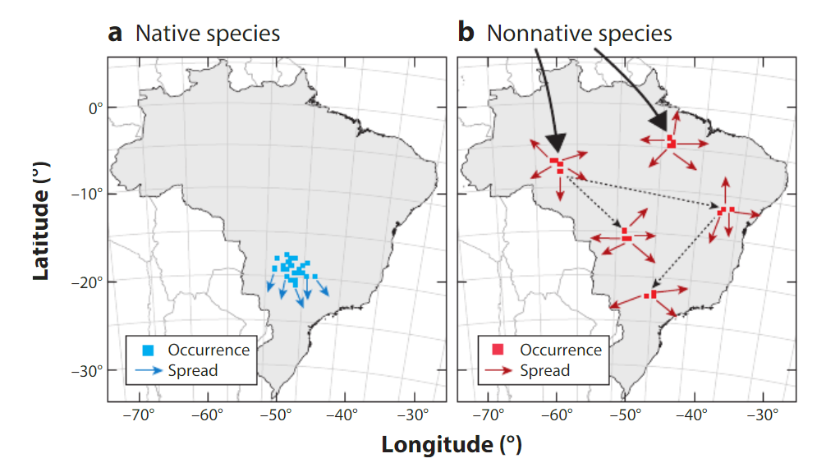
Introduction patterns influence spread rate
Bradley et al. 2024
Fertakos & Bradley 2024
Notes:
Species that are introduced in disparate locations have higher capacity for secondary spread. Traditionally this has favored non-natives. The rise of ecological landscaping and gardening may change that for native plants.

Slide 44
How does climate change affect all of this?

Slide 45
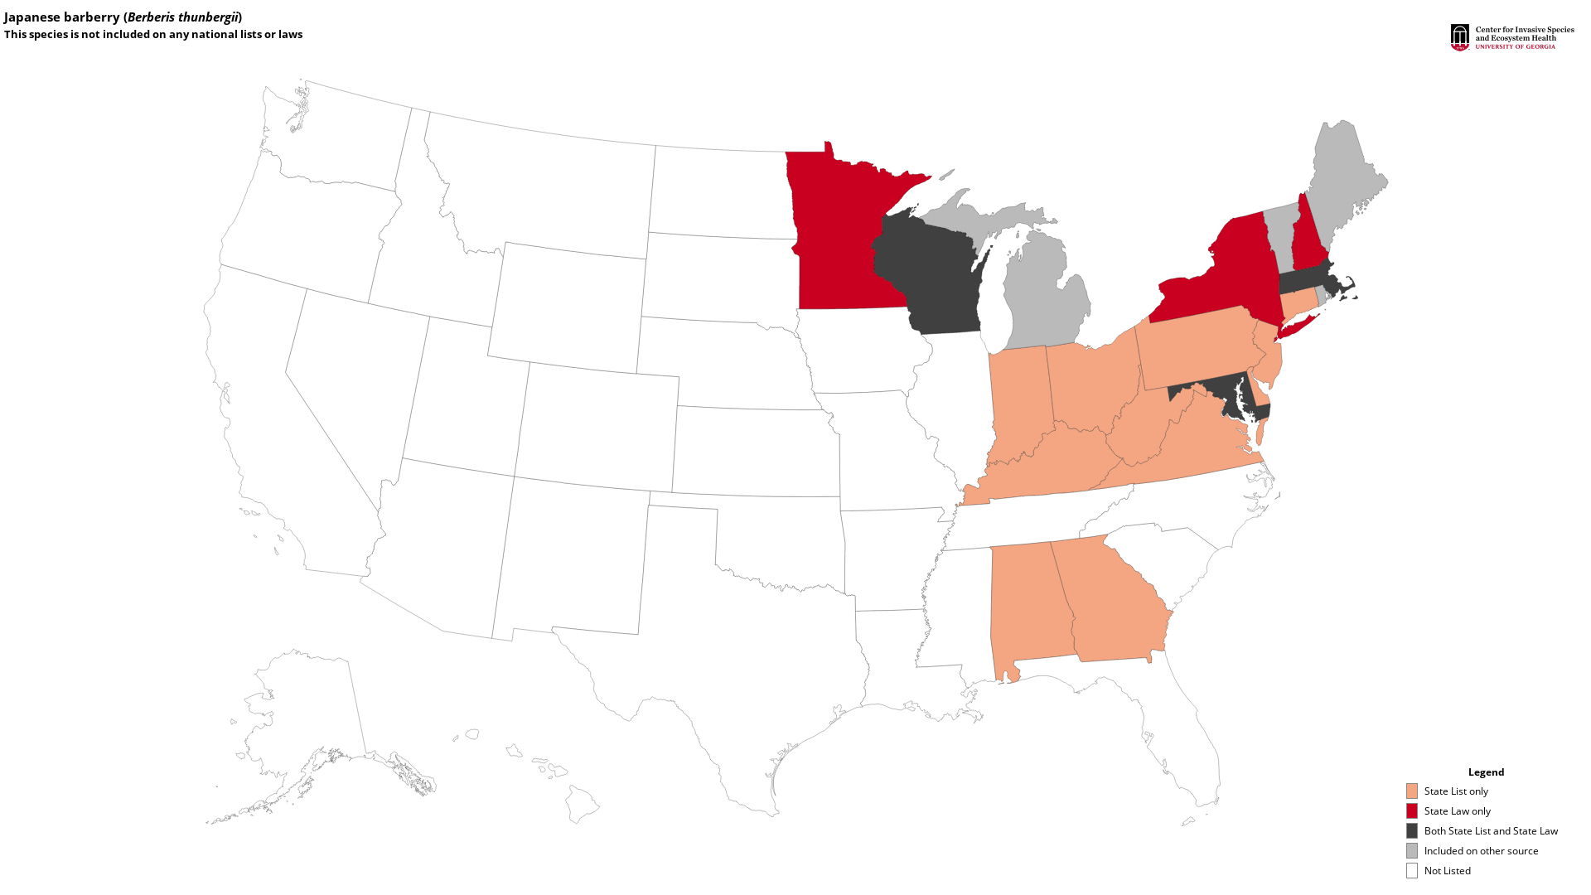
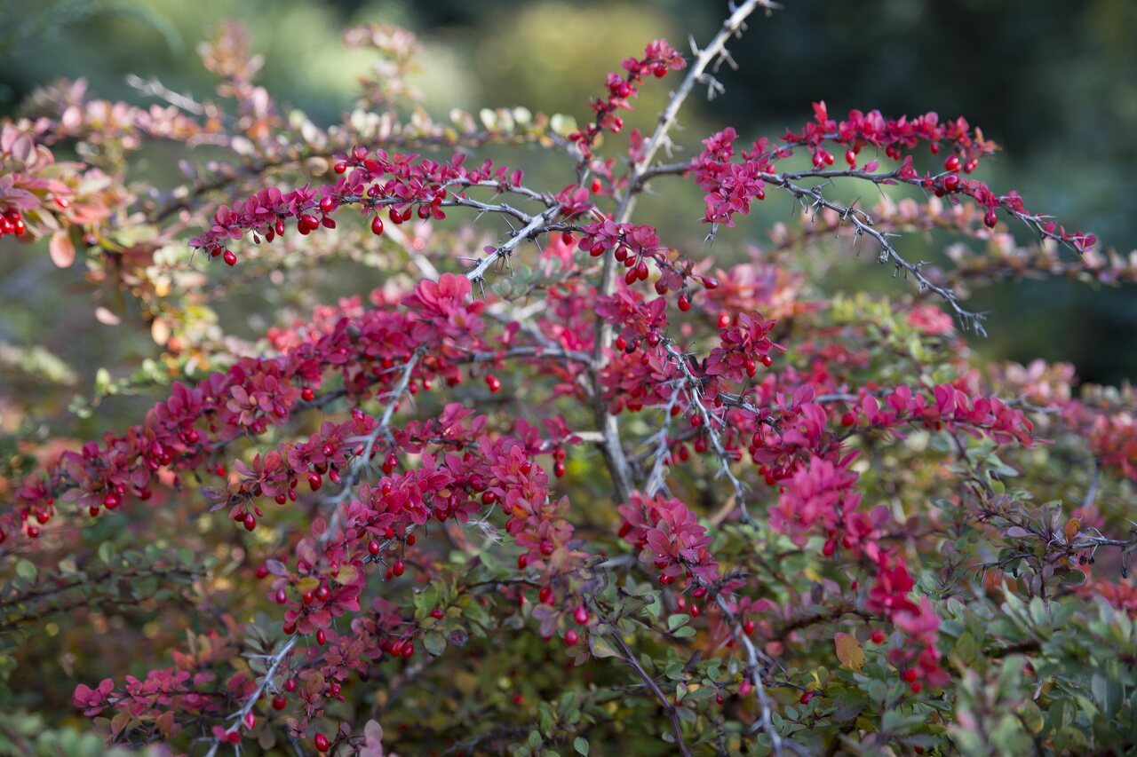
xs
Berberis thunbergii
Notes:
Matt

Slide 46
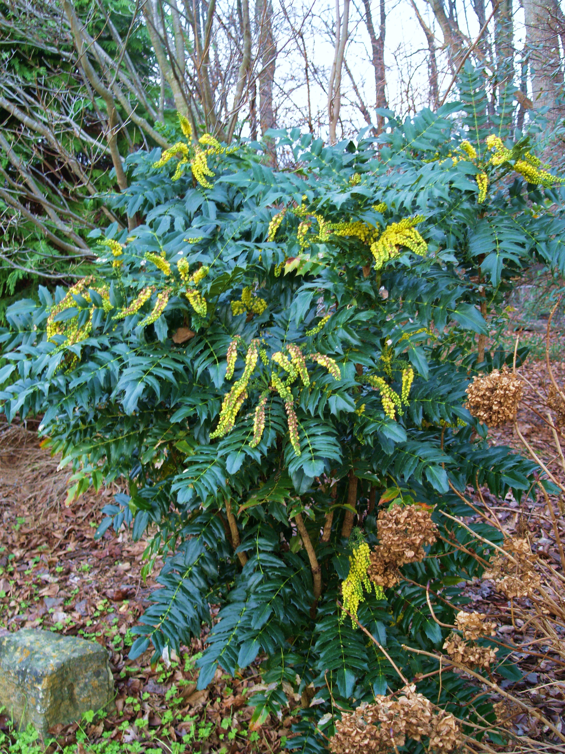
xs
Berberis (Mahonia) bealei
Berberis thunbergii
Notes:
Matt

Slide 47
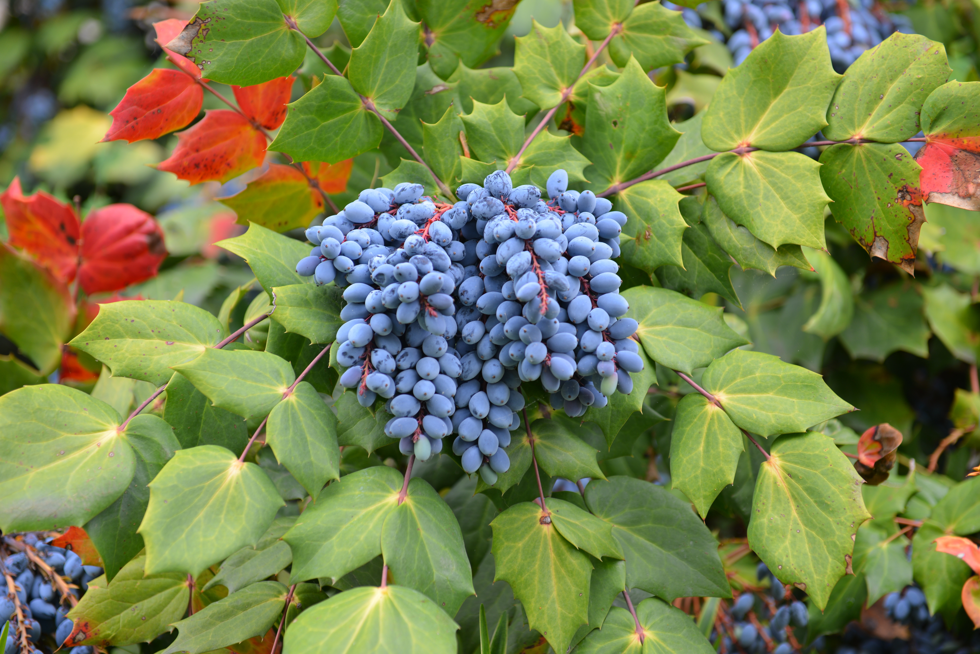
xs
Notes:
Matt

Slide 48
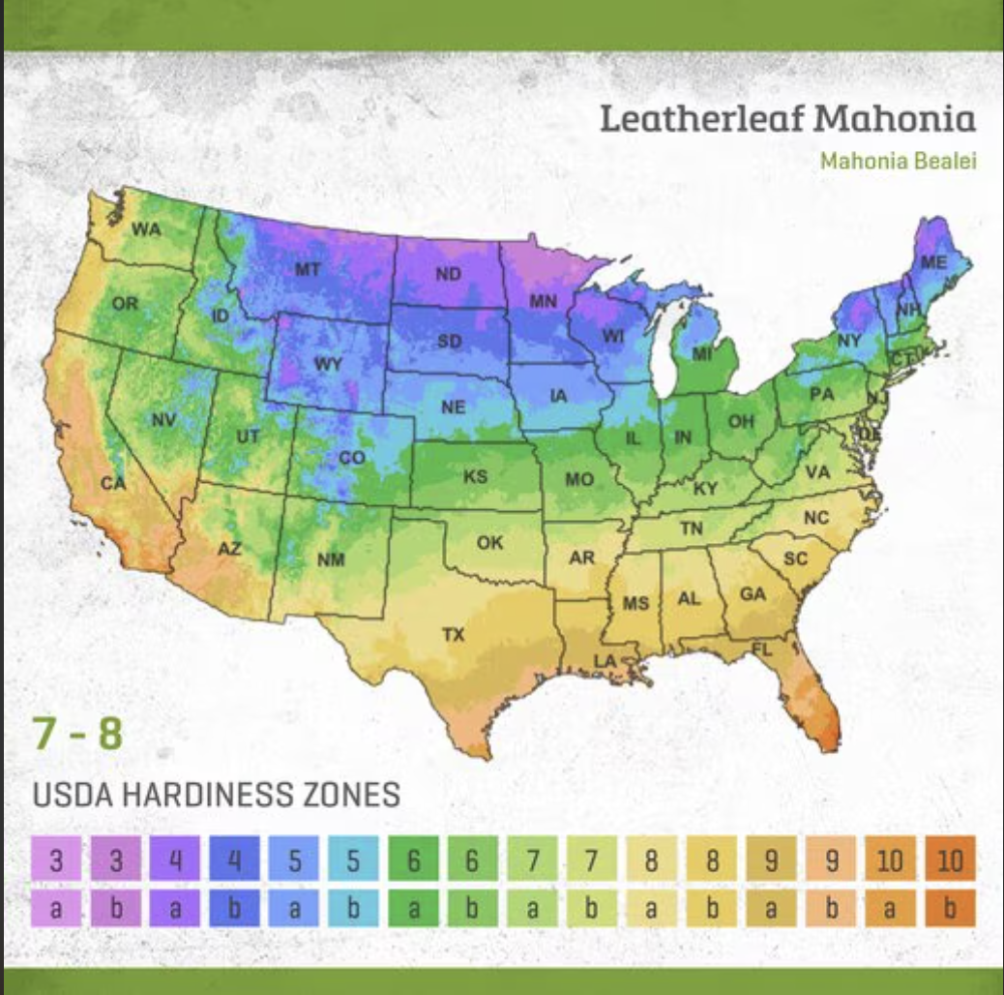
xs
Notes:
Matt

Slide 49
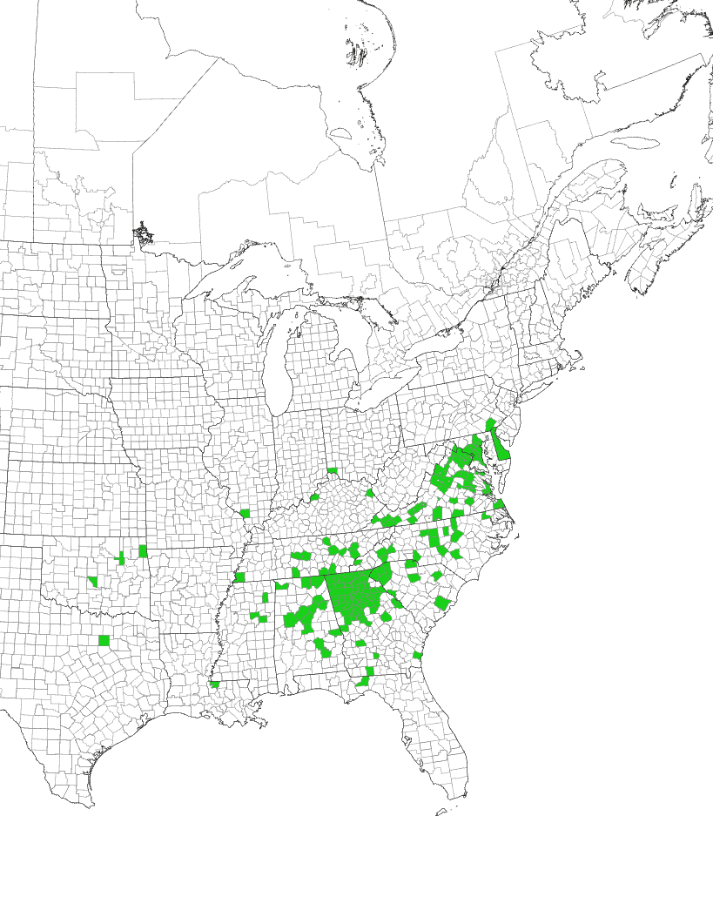
xs
Notes:
Matt

Slide 50
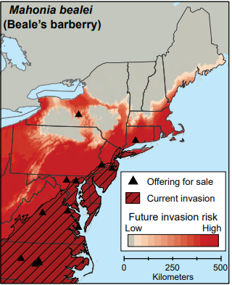
Selling outside of the current range
Out-of-range sale locations are within areas of future high invasion risk
Loci of future invasions,
promotes range expansion
Allen et. al 2022
Notes:
Walk through how nurseries selling outside of the current invaded range serve as the loci of future invasions as climate changes. Ideally sales stop in these locations and we avoid new locations selling.

Slide 51
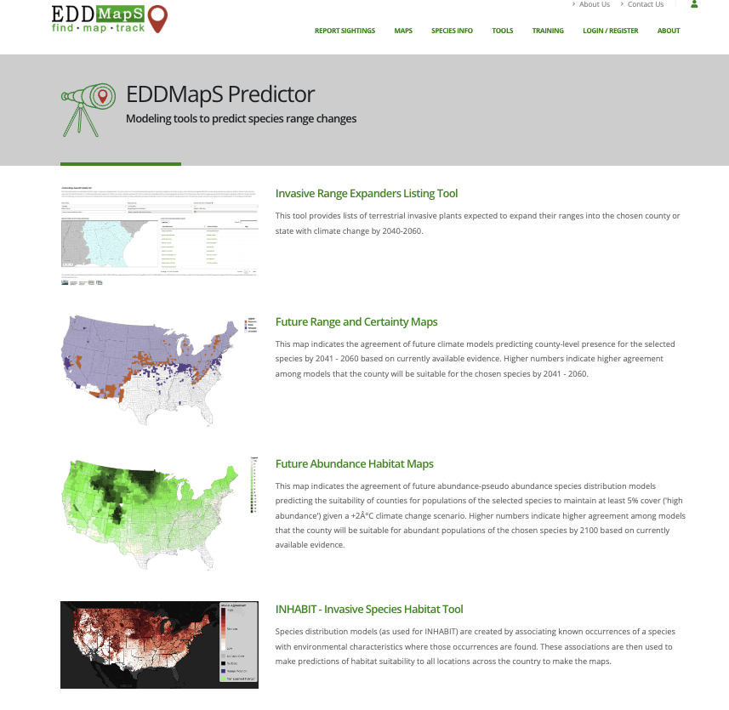


Slide 52


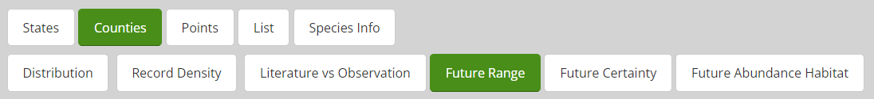


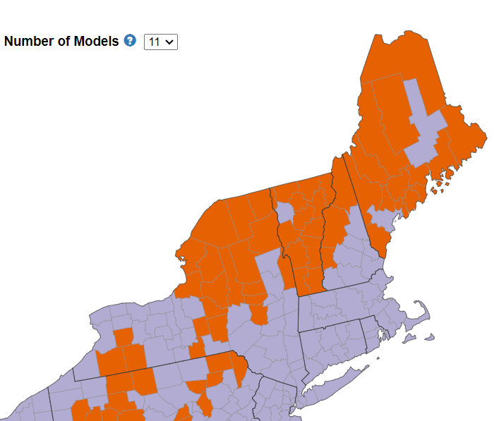
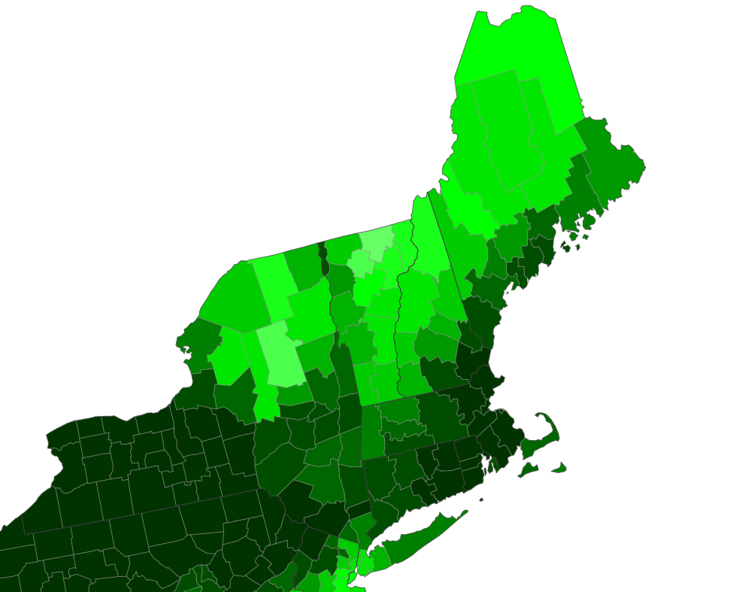
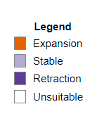
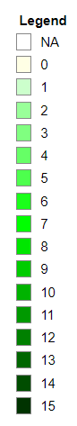
Species Range Shift Maps
Project funded by the Northeastern IPM Center through Grant #2014-70006-22484 from the National Institute of Food and Agriculture, Crop Protection and Pest Management, Regional Coordination Program and by the U.S. Geological Survey and the Northeast Climate Adaptation Science Center through grant # G21AC10233-01.
Notes:
Made all maps publicly accessible via EDDMapS

Slide 53
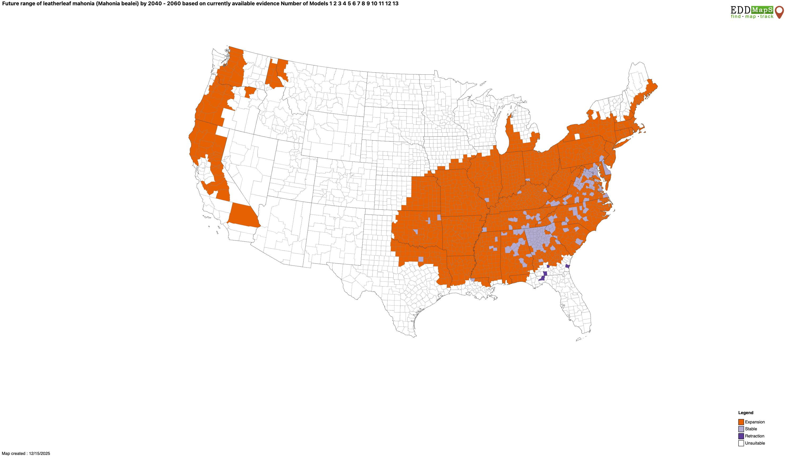

Slide 54
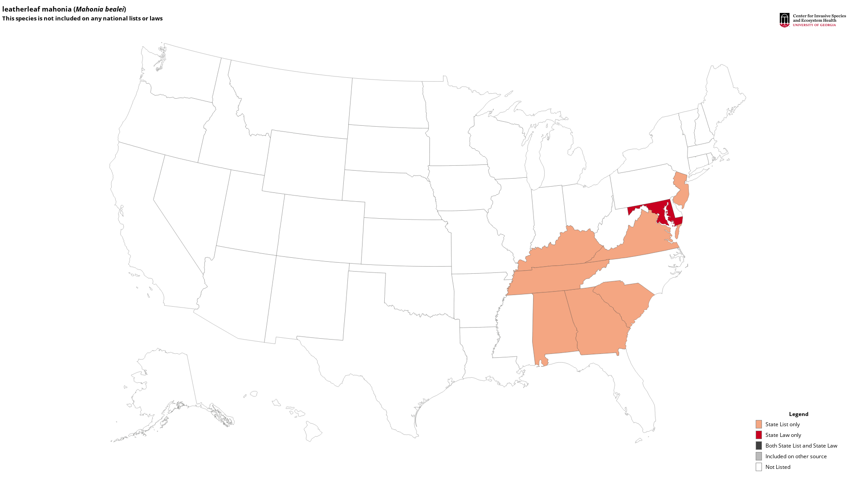
Notes:
What to do for plant selection

Slide 55
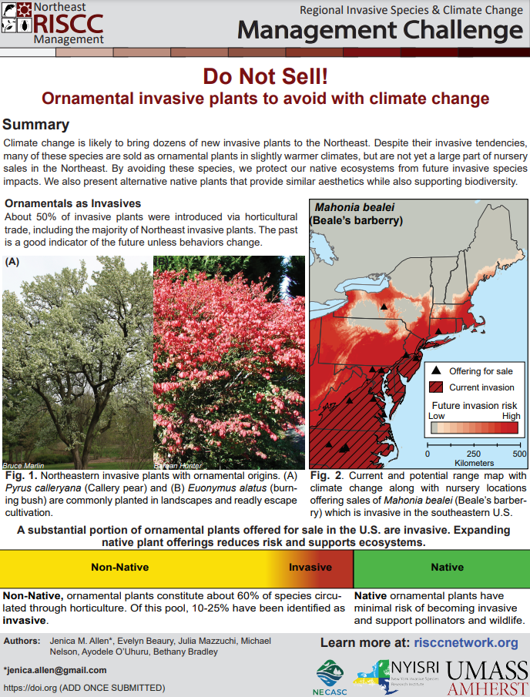
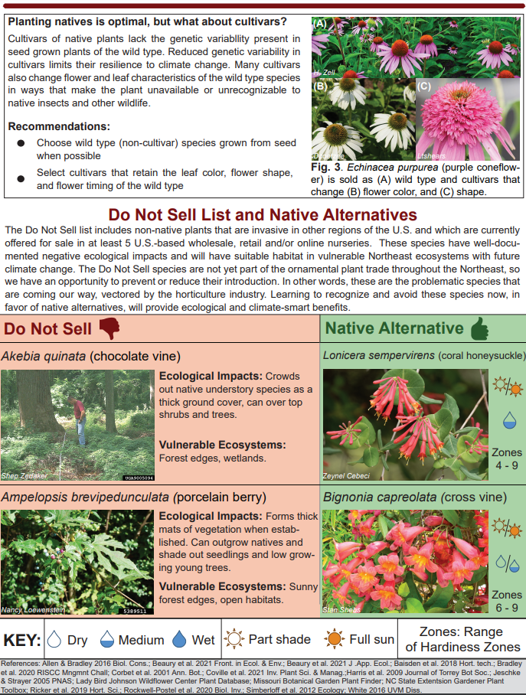
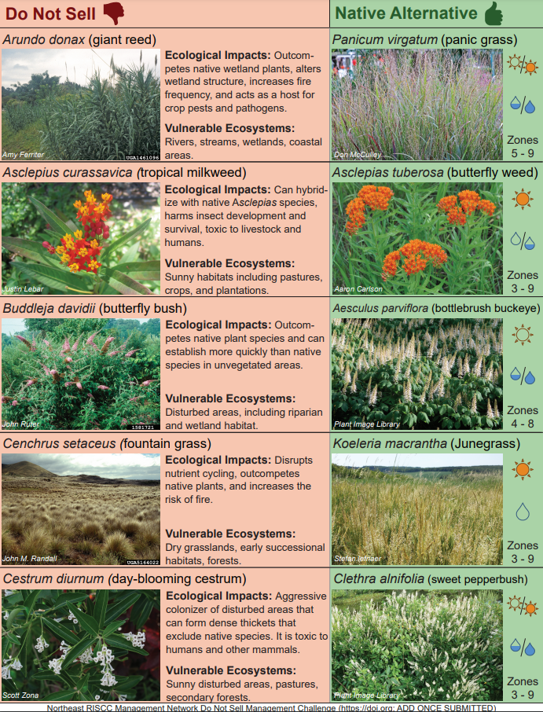
Proactively addressing new ornamental invasive plants
https://www.risccnetwork.org/research-to-practice
Allen et al. 2022
Notes:
24 do not sell species. These are species that have high ecological impact, vulnerable habitats in the region, are sold ornamentally in the U.S. but are not yet widespread across the northeast.
Basically, avoid them as money makers before they’re even part of the market.
Regulatory and voluntary actions for producers, nurseries, and consumers. Don’t design with these plants, even if they are available. Lots of good native alternatives available.

Slide 56
What does this mean for native plants?

Slide 57
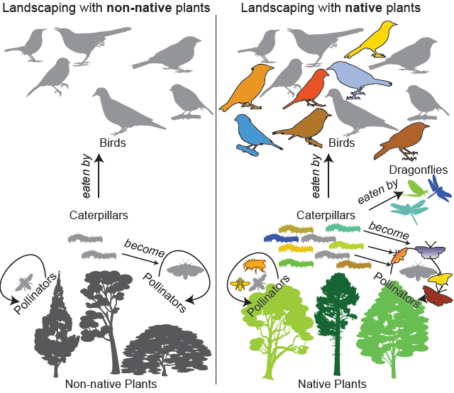





Native plants support native wildlife.
2x caterpillar diversity in native trees
Notes:
Native gardens support your local ecosystem. These benefits are emphasized here…
And this comes from the RISCC research to practice paper, “Why Native” that I mentioned earlier

Slide 58

Native plants have less risk of invasion and subsequent harm.
“Native Invaders” are rare among plants.
Simberloff et al. 2012
Notes:
Native plants are less likely have negative consequences than non-native species if they escape from gardens and establish in the natural environment.
A study from 2012 looked at all the vascular plants present in the United States and identified how many became invasive. For plants native to North America, this was less than half a percent, but for non-native species, more than 10% become invasive.
For example, Burning Bush (Euonymus alatus) native to Eastern Asia was introduced through the ornamental plant trade in the late 19th century, and has since escaped cultivation and is now invasive in the understory of many forests in the Northeast, choking out native species. Harm like this is not nearly as common with native species.

Slide 59


And of course, native plants are beautiful!
Photos: B. Bradley
Notes:
And of course they are beautiful!

Slide 60

Hardiness zones are already shifting
Plant hardiness zones are based on minimum winter temperatures, and are an estimate used by gardeners to determine what can grow at a given location.
USDA 2023
Notes:
These changes are already noticeable in the last decade as shown by shifting hardiness zones from the 1990s, to today, and projected to mid-century.
Plant hardiness zones are based on minimum winter temperatures, and are an estimate used by gardeners to determine what can grow at a given location.
We can see that since the 1990s hardiness zones have shifted by about ½ a zone corresponding to a 5 degree increase in minimum winter temperature, and by 2050 another ½ shift is expected.
These changing conditions are also changing what species can survive in gardens throughout our region.

Slide 61
Landscape designers will need to consider what species will persist in their area as the climate continues to change!
Climate-smart gardening: Planting for present and future conditions using native and near-native species adapted to both current and future hardiness zones.
Notes:
Therefore, gardeners will need to consider what species will persist in their area as the climate continues to change!
This is where what we call “climate-smart” gardening comes into play: planting for present and future conditions using native and near-native species adapted to both current and future hardiness zones.

Slide 62
Landscape designers will need to consider what species will persist in their area as the climate continues to change!
Climate-smart gardening: Planting for present and future conditions using native and near-native species adapted to both current and future hardiness zones.
Persistent species: Species which are suitable for both current and future hardiness zones of a given state.
Notes:
I’m going to break down and expand on these terms a bit later but for now these are some definitions of how we are going to classify species in our resource.
We define persistent species as…

Slide 63
Landscape designers will need to consider what species will persist in their area as the climate continues to change!
Climate-smart gardening: Planting for present and future conditions using native and near-native species adapted to both current and future hardiness zones.
Persistent species: Species which are suitable for both current and future hardiness zones of a given state.
Native species: Species historically found growing without human intervention in a given state.
Notes:
We define native species as…

Slide 64
Landscape designers will need to consider what species will persist in their area as the climate continues to change!
Climate-smart gardening: Planting for present and future conditions using native and near-native species adapted to both current and future hardiness zones.
Persistent species: Species which are suitable for both current and future hardiness zones of a given state.
Native species: Species historically found growing without human intervention in a given state.
Near-native species: Species that are not native to a given state but are native to a nearby state with a shared Level III Ecoregion.
Notes:
We define near-native species as…

Slide 65

Persistent native species in MA
Current + Future suitability
sp. range
Notes:
The following slides are going to be hypothetical examples from the perspective of a gardener based in Massachusetts to better explain these concepts.
This map shows areas of environmental suitability, basically the range of USDA hardiness zones it can tolerate, of a plant species being considered for a garden.
Areas of current suitability are in blue, the future in yellow, and the overlap, so where conditions will persist, in green. You can see the historic range of this species (in orange) is native to Massachusetts and falls within the green area of persistent conditions under future climate change. We would therefore classify this species as a persistent native and it would be a good species to plant in a garden in Massachusetts.

Slide 66
Persistent near-native species in MA
Current + Future suitability
USDA Ecoregions are a way of identifying areas of ecological similarity. Areas within the same ecoregion would be expected to have similar geology, landforms, soils, vegetation, climate, land use, wildlife, and hydrology.
Notes:
Plant communities don’t often follow political boundaries though, and that is where USDA ecoregions can help us determine what species are okay to plant across state lines.
USDA Ecoregions are a way of identifying areas of ecological similarity. The black outline now on the map to the coast shows areas which fall in the “Northeastern Coastal Zone” ecoregion. Areas within the same ecoregion would be expected to have similar geology, landforms, soils, vegetation, climate, land use, wildlife, and hydrology. Therefore, you would expect similar plant communities and a shared evolutionary history across states which overlap the same ecoregion, and plants within them to be safe to plant if environmental conditions will persist across state lines.

Slide 67

USDA Level III
Here is the Northeastern Coastal Zone Ecoregion used in our example!
Notes:
For context, here is what the level 3 ecoregions look like at a national scale. The ecoregion I just introduced can be seen on the right. Hopefully, this map gives you an idea of the size of the level 3 ecoregions we are making use of in our resource. We only include near native species on a state list if the focal state shares at least one level 3 ecoregion with a state in which the species is native.

Slide 68
Persistent near-native species in MA
Current + Future suitability
sp. range
Notes:
As an example, lets say we are interested in understanding whether this purple species is appropriate to plant in Massachusetts. We know its historic native range is in Connecticut, but falls within an ecoregion shared with Massachusetts.
We can also see that areas of suitability for this species are expected to persist within Massachusetts under future climate conditions. This species is therefore a persistent near-native species in Massachusetts.

Slide 69
Persistent near-native species in MA
Current + Future suitability
sp.
planting
Notes:
By planting near-native species as displayed here, you can actually help facilitate their movement tracking suitable habitat poleward in response to warming conditions, as we know the pace of climate change is much faster than native species will be able to move on their own. Because this movement is occurring within states of a shared ecoregion, the geographic distance the species is moving is not too great which reduces the risk of invasive behaviors while promoting climate adaptation.

Slide 70
The problems to planting native:
People don’t know what native species to plant.
It’s hard to know what native species are available in trade.
Climate change will alter what species will persist in an area.
Notes:
So, to summarize what I’ve gone over so far, the problems people encounter when trying to plant native gardens include:

Slide 71

To address this problem, we have created state lists of climate-smart native and near-native plants that are expected to persist under future climate conditions for use by home gardeners.
Notes:
To address this problem, our newest research to practice paper contains lists of climate-smart native and near-native plants that are expected to persist under future climate conditions for use by home gardeners. We call this ‘Climate-Smart Gardening 2.0’ because it is an expansion of our first climate-smart gardening resource that was released in 2020.

Slide 72


What species are available commercially?
Surveyed 339 nurseries in 15 states in the mid-Atlantic and Northeastern United States for native species currently for sale.
This resulted in the identification of 1,472 species native to the lower 48 U.S.
Notes:
To create lists of climate resilient native plant species for each state, we…
You can see a map of these nurseries displayed on the right. This is an example of a catalog from a nursery in PA we extracted data from. Through this process we identified 1,472 species native to the continental United States.
We started with what is offered for sale in nurseries in our region to ensure what we recommend is commercially available, to address this common problem encountered by users of other native plant lists.

Slide 73







Standardization and characteristics appended
Standardized taxonomy
Appended horticultural information (including optimal hardiness zones)
The states each species is native to was appended from the World Checklist of Vascular Plants¹
Aggressiveness (weediness) of each species was indicated based on descriptions in the Missouri Botanic Garden’s Plant Finder tool.
¹Govaerts, R., Nic Lughadha, E., Black, N. et al. The World Checklist of Vascular Plants, a continuously updated resource for exploring global plant diversity. Sci Data 8, 215 (2021)
Notes:
We then standardized taxonomy to the World Flora Online taxonomic backbone to account for the fact that scientific names are changing all the time and different names can be used to mean the same species.
We then appended growth, aesthetic, and ecological information for each species to allow the user to filter species for their specific gardening project or use. This information came from resources like the Missouri botanical garden’s Plant Finder Tool, Ladybird Johnson Wildflower Center, the department of transportations ecoregional revegetation application, the Manual of Woody Landscape Plants, and A-Z Encyclopedia of garden plants.
The states each species is native to was appended from the World Checklist of Vascular Plants.
We also flagged aggressive or weedy species based on descriptions from the Missouri Botanic Garden’s Plant Finder Tool. It is important to note that species described as aggressive or weedy which are native to a state may be desirable in some cases as a ground cover, or otherwise, and are not descriptions of the species as invasive.

Slide 74


Data filters
Species for which we found no optimal hardiness zone information were removed.
We filtered out rare, threatened, or endangered species from states where they are listed.
Viola rotundifolia
Endangered in RI
Imperiled in DE
Species regulated on any official state list within the region were excluded from all state lists.
Example: Robinia pseudoacacia (Black locust)
Notes:
Species for which we found no optimal hardiness zone information were removed.
We then filter out rare, threatened, or endangered species from states where they are listed. For example, Viola rotundifolia is endangered in Rhode Island and Imperiled in Delaware, so that species would not be recommended for planting in those states to avoid the wild collection of or the introduction of inappropriate genotypes near wild populations.
We also excluded any native species regulated by any state within our region. For example, Robinia pseudoacacia, or the Black locust tree, often behaves like an invasive species, escaping gardens and taking over local ecosystems so it is not recommended for planting in home gardens.

Slide 75

Identifying “climate smart” native plant species
To identify “climate smart” native species, we investigated if optimal hardiness zones persist in each state by mid-century under worst case future climate conditions for each species. A climate persister can survive current and future conditions within a state.
Current MA: 5 – 7
Future MA: 7 – 8
Near-native species were removed if a species was native to a state which did not share a level 3 ecoregion with the focal state.
Notes:
To identify “climate smart” native species, we investigated if optimal hardiness zones persist in each state by mid-century under worst case future climate conditions for each species. A climate persister can survive current and future conditions within a state. For example, in Massachusetts this would be a species which can persist despite the loss of hardiness zones 5 and 6 in the state by mid century. Near-native species were removed if a species was native to a state which did not share a level 3 ecoregion with the focal state. A species native to only Connecticut, and therefore near native to Massachusetts, would be included because they share the “Northeastern Coastal Zone” ecoregion, but a species native to only Virginia would not because Virginia and Massachusetts do not share a level 3 ecoregion.

Slide 76


Species
Native to MA?
Survive current conditions?
Survive future conditions?
Category
Climate-smart?
Ilex opaca
Persistent native
Notes:
Here are some examples of how we classified species as climate smart relative to a gardener in MA, but these concepts were applied to any state included in our lists.
American Holly (Ilex opaca) is native to MA and has an optimal hardiness zone of 5 to 9. These hardiness zones are present currently and are predicted to persist by mid century in the state so it is classified as a persistent native and we encourage planting by home gardeners.

Slide 77


Species
Native to MA?
Survive current conditions?
Survive future conditions?
Category
Climate-smart?
Ilex opaca
Persistent native
Rhododendron arborescens
Persistent near-native
But shares a level III ecoregion with MA
Notes:
Rhododendron arborescens is not native to MA but is native to nearby Pennsylvania which shares the “Northeastern Highlands” ecoregion with MA. It’s optimal hardiness zone range is 4 to 7 which will persist under current and future climate conditions. We classify this as a near-native species which a good candidate to be planted by home gardeners in MA.

Slide 78

Species
Native to MA?
Survive current conditions?
Survive future conditions?
Category
Climate-smart?
Ilex opaca
Persistent native
Rhododendron arborescens
Persistent near-native
But shares a level III ecoregion with MA
Prunus pensylvanica
Native loss
Notes:
Conversely, Fire Cherry (Prunus pensylvanica), we know this species is native to MA and can survive under current hardiness zones in the state. By mid century though, the 2 to 6 optimal hardiness zones for growing Fire Cherry will be lost as the lowest zone will be 7. This is a species gardeners would not want to plant as it will not persist, and is categorized as a native loss.

Slide 79

Species
Native to MA?
Survive current conditions?
Survive future conditions?
Category
Climate-smart?
Ilex opaca
Persistent native
Rhododendron arborescens
Persistent near-native
But shares a level III ecoregion with MA
Prunus pensylvanica
Native loss
Notes:
One note of caution thought on what we classify as persistent near native species. Near native species are color coded separately from native species in our resource so they are easily distinguishable. We did this because persistent near-native species aren’t historically native to the focal state
Most of the near native species on our list have a very low risk of invasion, especially because we filtered to only near native species which share a level three ecoregion with a focal state, but risk still does exist. We based this decision on an attempt to balance the minimal potential risk of invasive behaviors by some near-native species and the current available science in which we understand that native species are spreading 20 times slower than the pace of climate change and will not be able to keep up on their own making some movement of species necessary to facilitate their survival.

Slide 80


Reviewers
Finally, state lists were reviewed by experts (botanists, ecologists, horticulturalists) and additional updates were made to garden aggressiveness, common names, growth forms, taxonomy, and species were removed on a state-by-state or regional basis depending on feedback
New York Invasive Species Expo September 2023
Cornell Cooperative Extension Agriculture, Food, & Environmental Systems In-service Workshop November 2024
We are grateful for data reviews from 13 botanical, ecological, and horticultural experts, including Karen Lombard, Alyssa Siegel-Miles, and Victoria Wallace.
Notes:
Finally, lists were reviewed by botanical experts to filter out species that could be problematic in their region. We gathered feedback through two workshops with different versions of these lists and collected valuable feedback from each. We also had separate individual reviews from 13 botanical ecological and horticultural experts from states across our region including Karen Lombard, Alyssa Siegel-Miles, and Victoria Wallace. An example of helpful feedback we received was the identification of several species which are susceptible to widespread pests or pathogens (Fraxinus, Ulmus spp. [Elm]) and were subsequently removed as they would not make good persistent garden plants.

Slide 81





Dataset Stats
The resulting 15 state lists contain between 539 to 770 native and near-native species which are commercially available and predicted to persist under future climate conditions throughout the Northeast.
Photos: J. Allen

Slide 82



Slide 83
AGENDA
1
Invasive species and climate change: R.I.S.C.C.-y business
2
M.A.D. about climate change
3
Relocation-managed

Slide 84

Definitions
Managed relocation: The intentional introduction of genotypes or species outside of their historic ranges into more climatically favorable regions
Notes:
Managed relocation is the intentional introduction of genotypes or species outside of their historic ranges into more climatically favorable regions. There are two main components of this – the movement of genotypes and the movement of species.
Imagine that the green blob is the range of a given plant species and the trees are populations of the same species distributed throughout the range

Slide 85

Definitions
Cold margin
Managed relocation: The intentional introduction of genotypes or species outside of their historic ranges into more climatically favorable regions
Warm margin
Notes:
Populations of the same tree species exist along a climatic gradient (warm to cold)

Slide 86

Definitions – assisted gene flow
Managed relocation: The intentional introduction of genotypes or species outside of their historic ranges into more climatically favorable regions
Notes:
One part of managed relocation involves introducing warmer-adapted genotypes into cooler climates within its historical range. That’s also termed assisted gene flow and is what we’re focused on here.

Slide 87

Definitions – assisted species migration
Managed relocation: The intentional introduction of genotypes or species outside of their historic ranges into more climatically favorable regions
Notes:
Another part of managed relocation involves moving the species outside of its historical range. This is often termed assisted species migration.

Slide 88

The risk to ecosystems
Climate-driven population decline or local extinctions because conditions become too warm (or too wet/dry).
Notes:
And of course what we’re concerned about is that we will see population declines and even local extinctions at range margins because climate conditions have become too hot or too wet or too dry as the case may be.

Slide 89
Now, we’re focused on assisted gene flow
Notes:
We’re focused on assisted gene flow, not assisted species migration
Less risky

Slide 90


How far do plants need to move to keep up?
Notes:
Before we talk about approaches for assisted gene flow, let’s first talk about how far species need to move to keep up with climate change.
Scatter plot of points in the Northeast separated by a random north/south distance of up to 300 miles and then measuring the difference in temperature. These are in miles and Fahrenheit because it’s more intuitive for a lot of us to understand.
Our assumption is that plants are adapted to their current location. So, plants in Amherst should be adapted to the historical climate of Amherst.

Slide 91

Temperatures have already risen by ~2-3° F
You are here
Notes:
Focus on the orange line – you can see that temperatures have already risen by about 2.5 degrees F over the last 50 years (this is for Massachusetts). If you’re further north, you’ve probably warmed a bit more. If you’re further south, you’ve probably warmed a bit less.

Slide 92


A rise of ~2-3° F is equivalent to ~80-120 miles
Notes:
2-3 F is what we’ve already experienced. On average, this takes us 80-120 miles, or from Amherst to Port Jefferson on Long Island

Slide 93


A rise of ~5-7° F is equivalent to ~200-300 miles
Notes:
Projected warming is for the end of the century (2080-2100). On average, this takes us 200-300 miles, or about the distance from Amherst to Atlantic City.

Slide 94
Enter: Assisted gene flow
Managed relocation: The intentional introduction of genotypes or species outside of their historic ranges into more climatically favorable regions

Slide 95

Assisted gene flow is recommended for conservation
1. Assist transitions, population adjustments, range shifts, and other natural adaptations
…
3. Expand genetic diversity guidelines
Millar et al. 2007
Notes:
First of many academic papers saying that this action is necessary in the face of rapid climate change – specifically for forests. Since at least 2007 conservation biologists have been saying that we need to assist transitions of species and in particular expand genetic diversity guidelines to be able to move warm-adapted genotypes

Slide 96

Assisted gene flow is recommended for conservation and restoration
“Reference models should be developed with an explicit focus on understanding temporal dynamics to develop feasible and relevant restoration designs that allow local species to recover, adapt, evolve, and reassemble.”
Gann et al. 2019
Notes:
Standards for ecological restoration
This is science jargon speak meaning that we can’t use the historical genotypes, species, or communities as a reference for restoration in the context of climate change

Slide 97

Assisted gene flow is recommended for conservation and restoration and management
Notes:
In 2023, the US Fish & Wildlife Service updated the rules associated with the endangered species act to allow for species to be restored not only within their historical range, but also into new ranges accounting for climate change

Slide 98

Options for sourcing seeds
Prober et al. 2016
Notes:
In our synthesis, we focused on three options for sourcing seeds for conservation or restoration – local, admixture, and climate-adjusted provenancing.

Slide 99

Options for sourcing seeds
Prober et al. 2016
Notes:
Local provenancing, seeds are sourced locally within the geographic or ecological region of the restoration site (so this is how restoration has historically been done)

Slide 100
Options for sourcing seeds
v
Prober et al. 2016
Notes:
In admixture provenancing, seeds are sourced both locally and from more distant regions in all directions with similar seed collection efforts. This is a good approach if we know things are changing, but don’t really understand the direction of change.

Slide 101
Options for sourcing seeds
Prober et al. 2016
Notes:
In climate-adjusted provenancing, seeds are sourced both local and from more distant regions in the direction of expected climate change, with more seed collection in the more distant regions. This approach is recommended when the environment is changing and we have a good idea of the direction of change (like for climate change).

Slide 102
And when to use them
Notes:
Each of these options for sourcing seeds has a place in our portfolio. For example, local provenancing remains a recommended choice if the target species has multiple populations or a large population locally. Optimally, we might also know that the population has high genetic diversity and gene flow. Local provenancing also remains a recommended choice if the site is in a stable environment with lower environmental disturbance.

Slide 103
And when to use them
Notes:
Admixture provenancing is recommended if the local population shows some signs of decline. That might include information about low genetic diversity or low dispersal capability. Importantly, admixture provenancing makes sense if the restoration site is experiencing a lot of environmental change, but the direction is uncertain (e.g., unclear whether it’s getting wetter or drier).

Slide 104
And when to use them
Notes:
And then finally, climate-adjusted provenancing is also recommended if the local population shows some signs of decline. And the restoration site is experiencing a lot of environmental change but we’re pretty confident about the direction (e.g., warmer).

Slide 105


Example of one study in the eastern U.S.
Woolridge et al. 2023
Notes:
This was a study done in Illinois – this is a very small field, we’ve only been able to find half a dozen studies that compare plant performance for local provenancing versus climate-adjusted provenancing. This study focused on three species and gathered seeds from three sites – a northern, a southern, and a local site that were all planted in a common garden – the star next to Lake Michigan

Slide 106

Example of one study in the eastern U.S.
Allium cernum
Woolridge et al. 2023
Notes:
For Allium cernum (nodding onion), the plants that had the highest overall fitness were actually from a cooler/northern population. For this species, admixture provenancing would be the best approach to build a resilient population.

Slide 107
Example of one study in the eastern U.S.
Chamaecrista fasciculata
Woolridge et al. 2023
Notes:
For partridge pea, the plants with the highest overall fitness were from the southern, warm-adapted source, suggesting that the best approach for conservation of this species uses climate-adjusted provenancing

Slide 108
Example of one study in the eastern U.S.
Rudbeckia hirta
Woolridge et al. 2023
Notes:
And lastly, for black-eyed susan (which didn’t have a northern seed source), the local population had the highest overall fitness, suggesting that this species has sufficient capacity to adapt through local provenancing.

Slide 109
We need experiments to know what to do!
Three species with three different results is not enough to build general guidelines.

Slide 110

Supply limits what gets planted
xs
Tangren et al. 2022

Slide 111


Slide 112


Slide 113

We need experiments to know what to do!
Use landscape projects as opportunities for adaptation experiments
Nadeau et al. 2024
Notes:
This is a recent paper that calls for restoration sites to build adaptation experiments and it includes an example and protocol from a common garden in Maine

Slide 114

Are you doing experiments? Please tell us!
Notes:
We suspect that a lot of work is happening outside of what’s available in scientific publications. This QR code will take you to a google form survey where we’re trying to compile information about who is conducting assisted gene flow (whether there’s an associated experimental study or not!). You can also find the QR code link to the form at the end of the research to practice paper

Slide 115

THANK YOU!
dbuona@umd.edu

